Slide 1
INTRODUCTION TO THE MODULE &
Lecture 1 - Overview of Management
Managing Business

Slide 2
Name of Module : Managing Business
Assessment and Marking Percentage
1. In-Course Assessment
(i) Group Assignment = 30%
(3,000 words)
(ii) Test (True/False & MCQ) = 20%
2. Final Exam (2 hours) = 50%
Code : ABUS002-4-1

Slide 3


Planned Schedule of In course Assessments

Slide 4
Learning Outcomes
At the end of the lecture, you should be able to:
  Describe the four functions of management.
  Explain Mintzberg’s managerial roles.
  Describe Katz’s three essential managerial skills.

Slide 5

Who Are Managers?
Manager
  Someone who coordinates and oversees the work of other people so that organisational goals can be accomplished.

Slide 6
Classifying Managers
First-line Managers
  Individuals who manage the work of non-managerial employees.
Middle Managers
  Individuals who manage the work of first-line managers.
Top Managers
  Individuals who are responsible for making organisation-wide decisions and establishing plans and goals that affect the entire organisation.

Slide 7
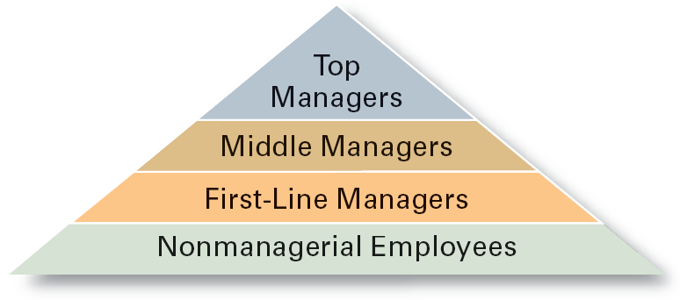
Managerial Levels

Slide 8

What Is Management?
Managerial Concerns
  Efficiency
    “Doing things right”
      Getting the most output for the least inputs
  Effectiveness
    “Doing the right things”
      Attaining organisational goals

Slide 9
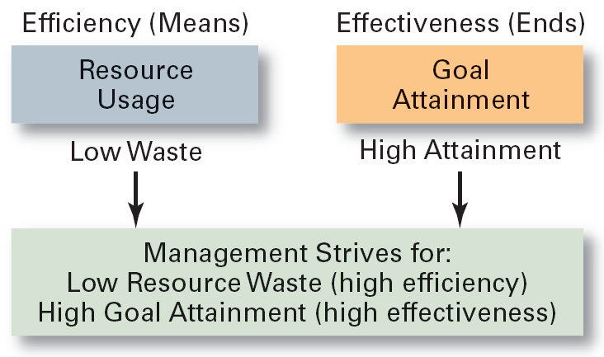
Effectiveness and Efficiency in Management

Slide 10
What Do Managers Do?
Functional Approach
  Planning
    Defining goals, establishing strategies to achieve goals, developing plans to integrate and coordinate activities.
  Organising
    Arranging and structuring work to accomplish organisational goals.
  Leading
    Working with and through people to accomplish goals.
  Controlling
    Monitoring, comparing, and correcting work.

Slide 11
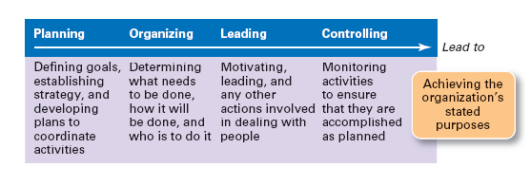
Management Functions

Slide 12

What Do Managers Do? (cont’d)
Management Roles (specific action/behaviours expected of and exhibited by a manager) Approach (Mintzberg)
  Interpersonal roles
    Figurehead, leader, liaison
  Informational roles
    Monitor, disseminator, spokesperson
  Decisional roles
    Entrepreneur, disturbance handler, resource allocator, negotiator

Slide 13
What Managers Actually Do (Mintzberg)
Interaction
  with others
  with the organisation
  with the external context of the organisation
Reflection
  thoughtful thinking
Action
  practical doing

Slide 14
What Do Managers Do? (cont’d)
Skills Approach
  Technical skills
    Knowledge and proficiency in a specific field
  Human skills
    The ability to work well with other people
  Conceptual skills
    The ability to think and conceptualise about abstract and complex situations concerning the organisation

Slide 15
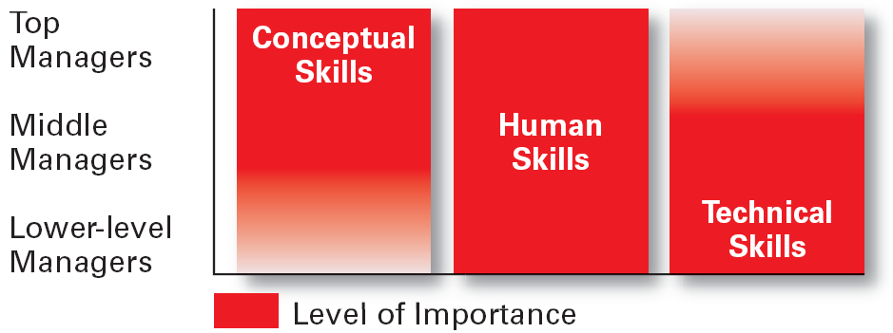
Skills Needed at Different Management Levels

Slide 16
Conceptual Skills
Using information to solve business problems
Identifying of opportunities for innovation
Recognising problem areas and implementing solutions
Selecting critical information from masses of data
Understanding of business uses of technology
Understanding of organisation’s business model

Slide 17
Communication Skills
Ability to transform ideas into words and actions
Credibility among colleagues, peers, and subordinates
Listening and asking questions
Presentation skills; spoken format
Presentation skills; written and/or graphic formats

Slide 18
Effectiveness Skills
Contributing to corporate mission/departmental objectives
Customer focus
Multitasking: working at multiple tasks in parallel
Negotiating skills
Project management

Slide 19
Effectiveness Skills (cont’d)
Reviewing operations and implementing improvements
Setting and maintaining performance standards internally and externally
Setting priorities for attention and activity
Time management

Slide 20
Interpersonal Skills
Coaching and mentoring skills
Diversity skills: working with diverse people and cultures
Networking within the organisation
Networking outside the organisation
Working in teams; cooperation and commitment

Slide 21
Summary of Main Teaching Points
  Explain why efficiency and effectiveness are important to management.
  Discuss the three major types of skills needed by managers.
  Describe how managerial jobs differ according to hierarchical level and responsibility area.

Slide 22
Question and Answer Session
Q & A

Slide 23
Next Session
Topic and Structure of next session
NEXT LESSON:
Nature of Organisation

